Slide 1

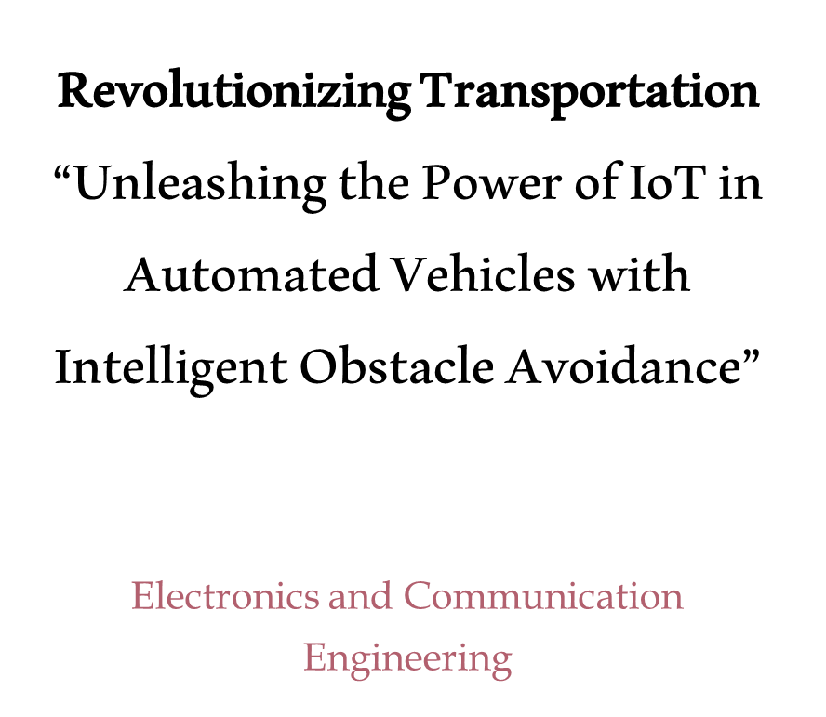
Project : UROP Mentor : Dr. Satish Kumar Tiwari Group : 13
SUBMITTED BY :
Student Name : P.PRUDHVI KRISHNA
NIKHILA KUMARI VOLETI
Registration Number : AP20110020021
AP20110020090
Branch and Section : ECE – A
ECE – B
College /University : SRM University – AP
Electronics and Communication
Engineering

Slide 2


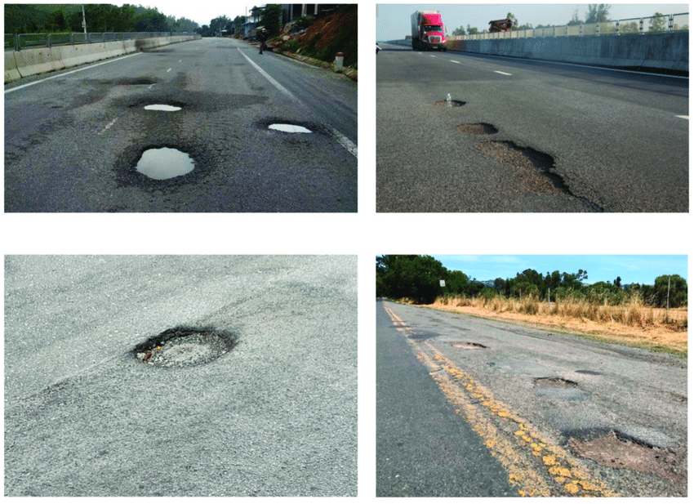
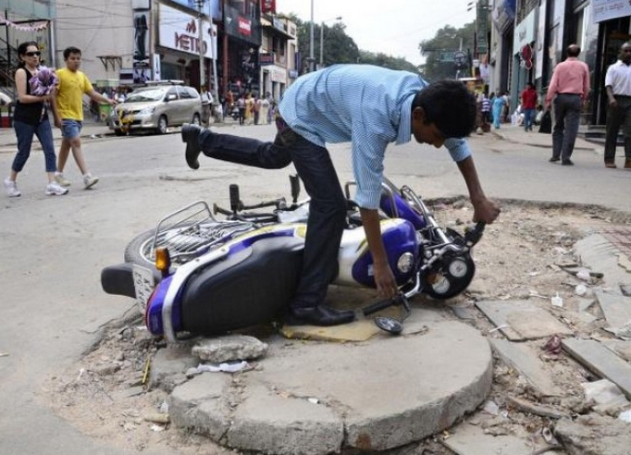
MOTIVATION
Road accidents are pervasive and prove to be fatal.
So, we have developed a kind of thing which deals with the construction and working of a device for obstacle detection.
Road accident are being increased due to potholes on roads

Slide 3

LITERETURE SURVEY
Reference number | Publication /patent title | Advantages | Disadvantages
[1] | Sensors for obstacle Detection in traffic scene situation | Got an idea about combined use of different types of sensors. | No algorithms are designed to reliably detect and warn for any obstacle that can appear in front of the car.
[2] | A Review of Vision-Based On-Board Obstacle Detection and Distance Estimation in Railways | Clarity about the three aspects rail track extraction, detection of obstacles and estimation of distances | No proper discussion of the distance estimation in railways.
[3] | Obstacle detection using ultrasonic sensor for a moving robot | Learned about the different applications when designing moving robot. | There is no clarity on implementation for a moving robot.
Novelty

Slide 4

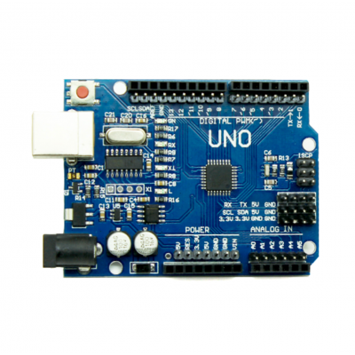
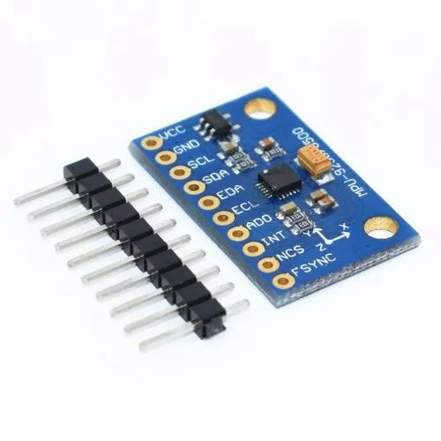
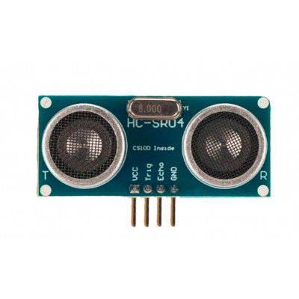
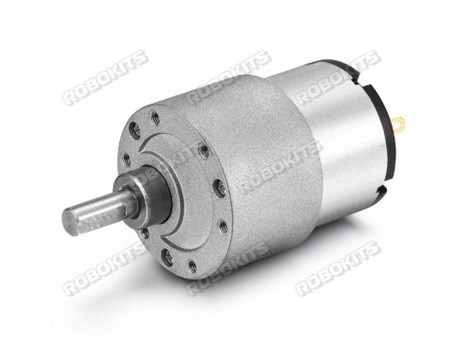
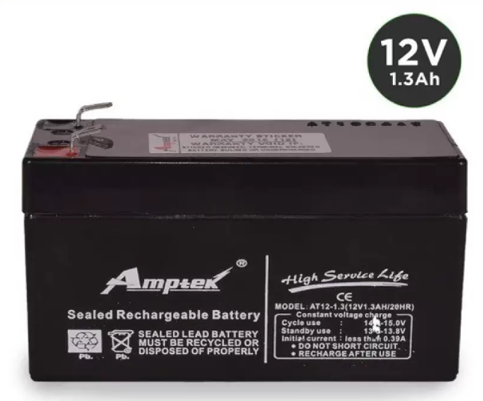
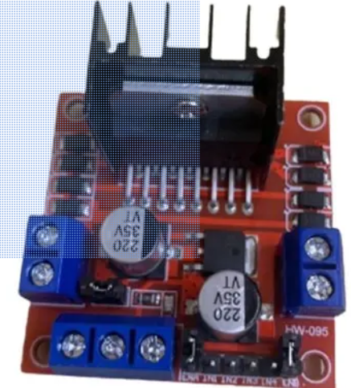
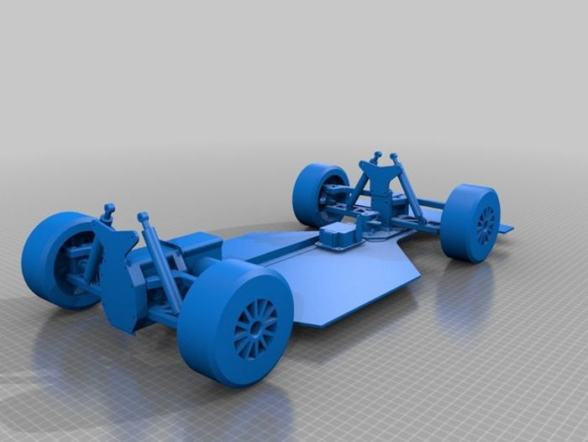
Components Required
Arduino UNO Board
ADXL-345
Ultrasonic Sensor
Gear Motor
Tzone 12V 1.3AH LEAD ACID BATTERY
Bluetooth Sensor HC-05
Motor Drive
Chassis: body part, wheels, etc.,
4

Slide 5
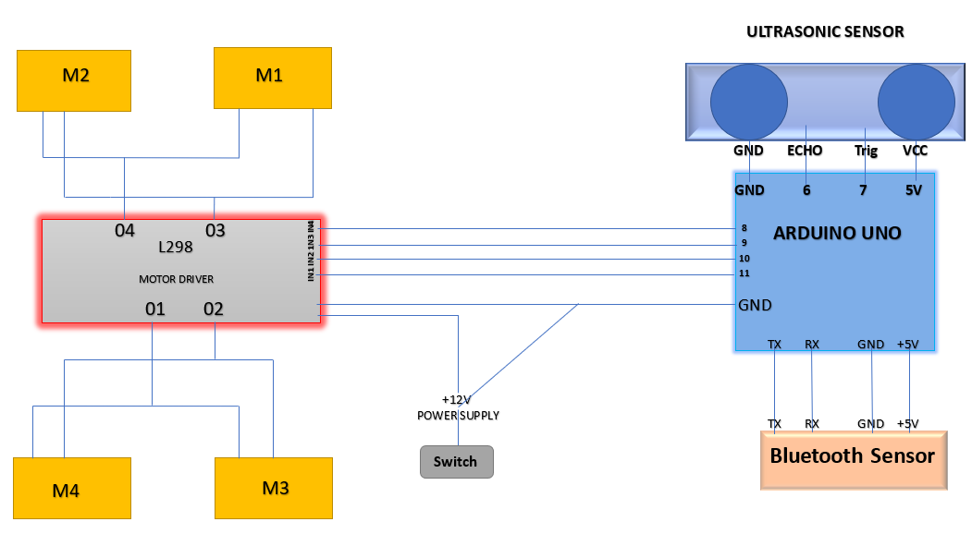
Block Diagram

Slide 6
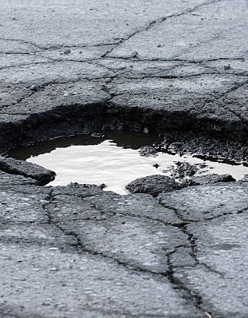

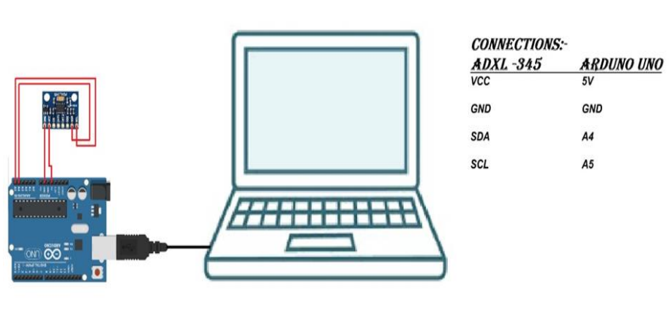
Implementation
Structural Health Monitoring of
Road Surface using Sensors
By using Arduino UNO Board and ADXL – 345 Sensor we have implemented this and observed the graphs.
Accelerometer gives the reading of acceleration of three axis in 13 bit, but Arduino can process 8 bit data thats why we send the data in two goes.
We print the output of the data given by ADXL345 in the format of x, y, z. whose 1 unit reading is equivalent to 1g(9.81m/s^2)
6

Slide 7
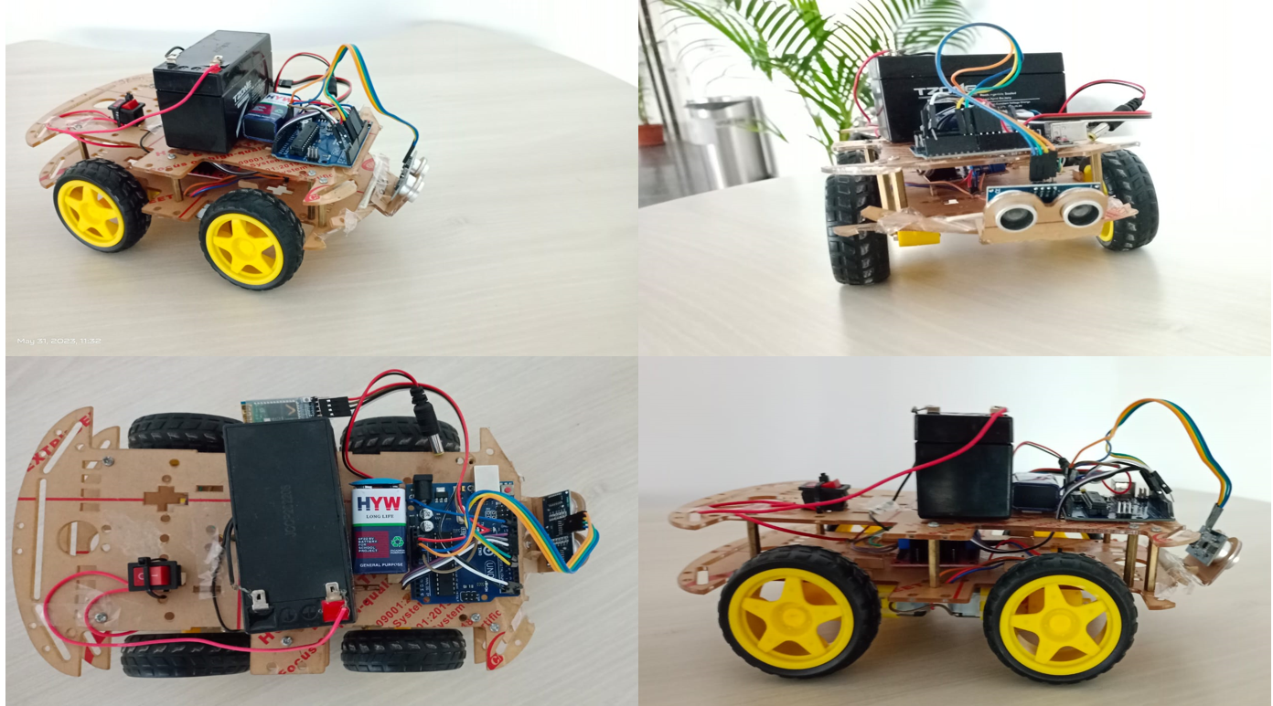
DEVELOPED PROTOTYPE

Slide 8
SUMMARY
The proposed outcome deals with the construction and working of a device for obstacle detection.
The proposed system automatically turns left and right on detecting obstacles using ultrasonic sensors and Bluetooth sensor which are connected through IoT.
The primary focus is to make the vehicle secure and to ensure the safety of the driver and passengers.
Proposed an out come for Structural Health Monitoring Systems

Slide 9
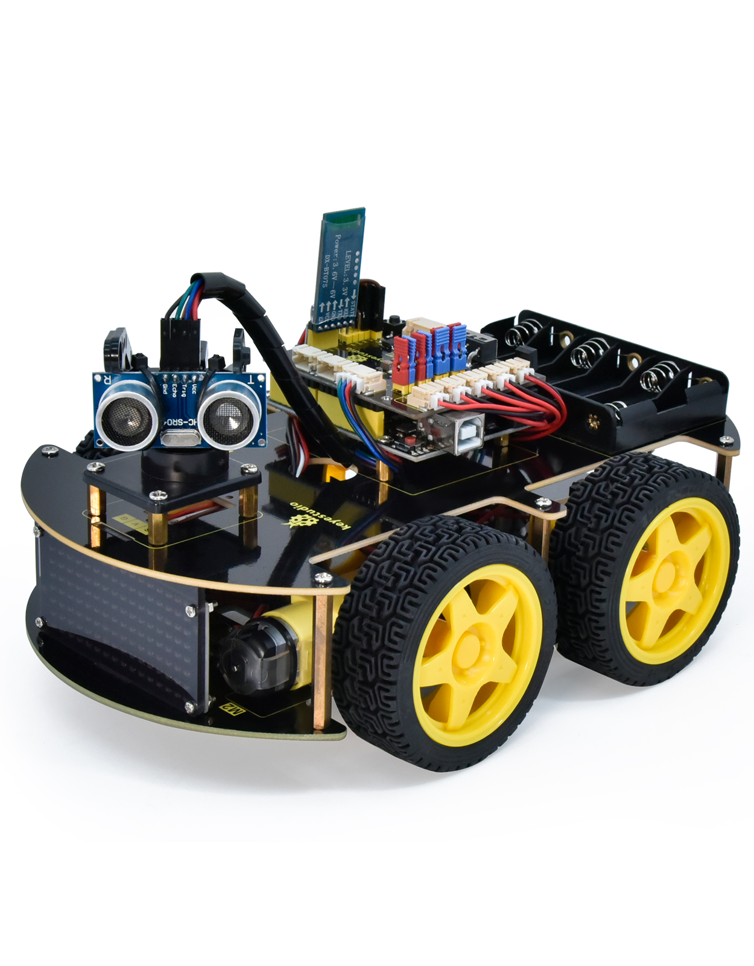
Future Scope
Structural Health Monitoring of
Road Surface using Sensors
Further research can be carried out to analyze the mobile phone sensors data during road journey.
An android applications can be Implemented for safety of drivers so they be careful to avoid mishaps.
This study can also explore to monitor structural health of roads.
9

Slide 10

References
[1] N. Sanil, P. A. N. venkat, V. Rakesh, R. Mallapur and M. R. Ahmed, "Deep Learning Techniques for Obstacle Detection and Avoidance in Driverless Cars," 2020 International Conference on Artificial Intelligence and Signal Processing (AISP), Amaravati, India, 2020, pp. 1-4, doi: 10.1109/AISP48273.2020.9073155. [2] A. Kosaka and A. Kak, "Fast vision-guided mobile robot navigation using model- Based reasoning and prediction of uncertainties", CVGIP Image Understanding, vol. 56, no. 3, pp.271-329, Nov. 2021. [3] K. A. . Mohamad, A. A. . Aziz, and A. . Alias, “Obstacle Detection System for Railways using IoT Sensors ”, EEEE, vol. 1, no. 1, pp. 57–63, Oct. 2020. [5] Moazzam, I.; Kamal, K.; Mathavan, S.; Usman, S.; Rahman, M. Metrology and visualization of potholes using the microsoft kinect sensor. In Proceedings of the 2013 16th International IEEE Conference on Intelligent Transportation Systems- (ITSC), The Hague, The Netherlands, 6–9 October 2018; pp. 1284–1291.

Slide 11

THANK YOU
Any queries

